Slide 1



Kshaya Mukta Grama Panchayat
Towards TB Free Panchayats
Dr. Arundhathi Chandrashekar IAS
Mission Director, NHM, Karnataka
24th March 2022

Slide 2
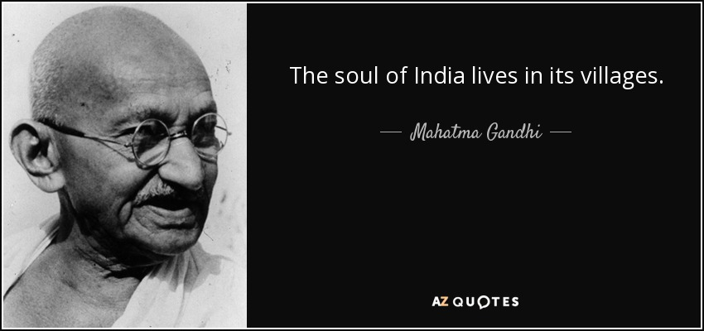










Slide 3
Tuberculosis burden
Period | Population ( in lakhs) | Total cases notified | Case Notification rate (per lakh population)
2018 | 668 | 82640 | 124
2019 | 676 | 91318 | 135
2020 | 704 | 65986 | ⁹⁴
2021 | 716 | 72659 | ¹⁰¹
In 2021 , out of all notifications 46,842(65%) cases are from rural area and 25817(35%) cases are from urban area

Slide 4
Need for Involvement of GPs in NTEP
Government of India mandate for Ending TB by 2025
Need for urgent attention and active involvement ( ownerships) of elected representatives.
Decision making bodies at local level have potential to proactively affect TB policies
GPs understand the demography, local context, available resources and existing challenges in the health care system
GPs are critical assets to provide solutions and fast track TB elimination activities

Slide 5
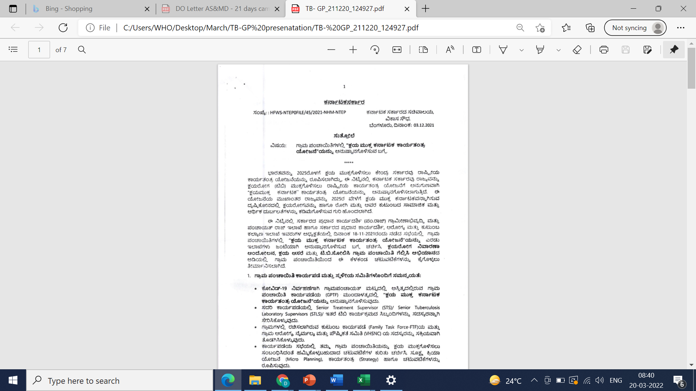
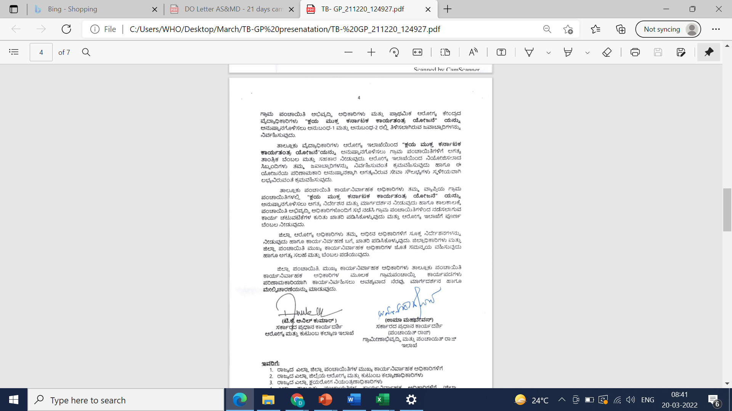
Joint Circular from PRS – RDPR and PRS-Health

Slide 6
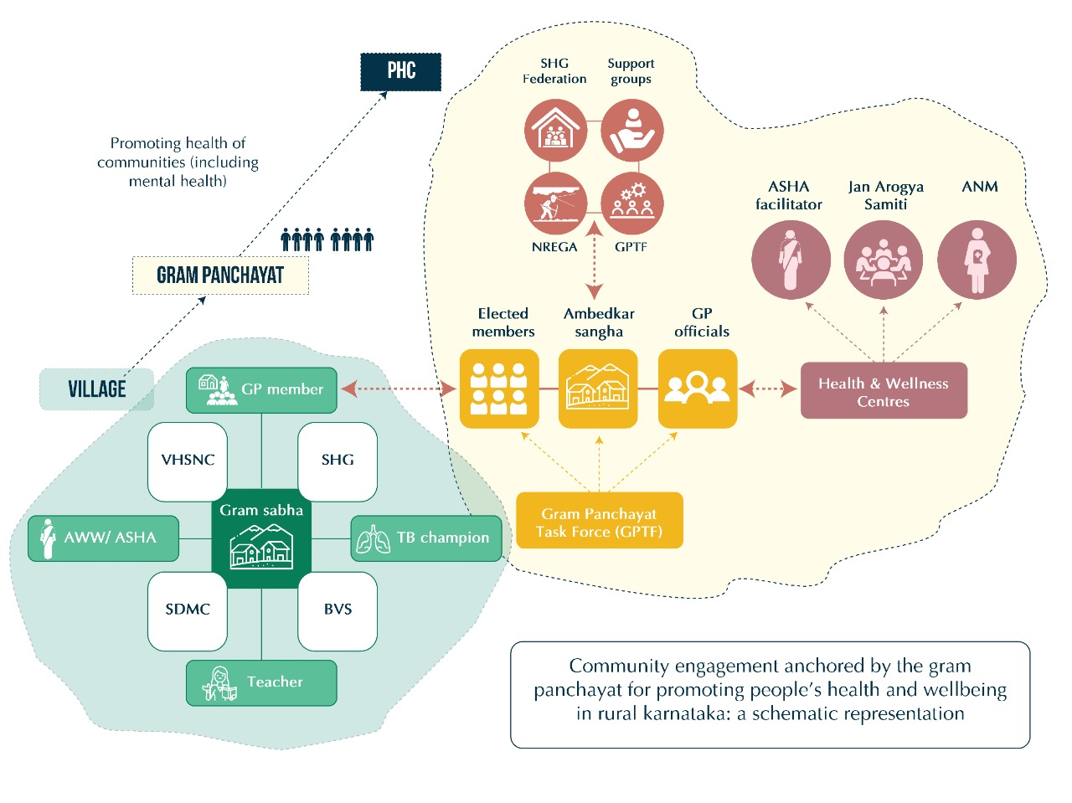
Kshaya Mukta Grama Panchayat Goal
To enable Grama Panchayats to achieve TB free status through whole of government approach.
Through NTEP PIP – 500 GPs, KHPT – 2872 GPs are engaged
Convergence Model: Integration of GPs with Primary Health Centre/Health Wellness Centre services
Activities have started from January 1st week of 2022

Slide 7
Kshaya Mukta Grama Panchayat Activities
Capacity Building
Alignment of TB activities with Health Task force of GP
Supervision and monitoring
01
07
02
KMGP- Activities
TB Sollisi GP Gellasi campaign
Graama Panchayath Arogya Amrutha Abhiyaana
06
03
05
04
Kshaya Aasare
Kshaya Nivarana Andolana

Slide 8
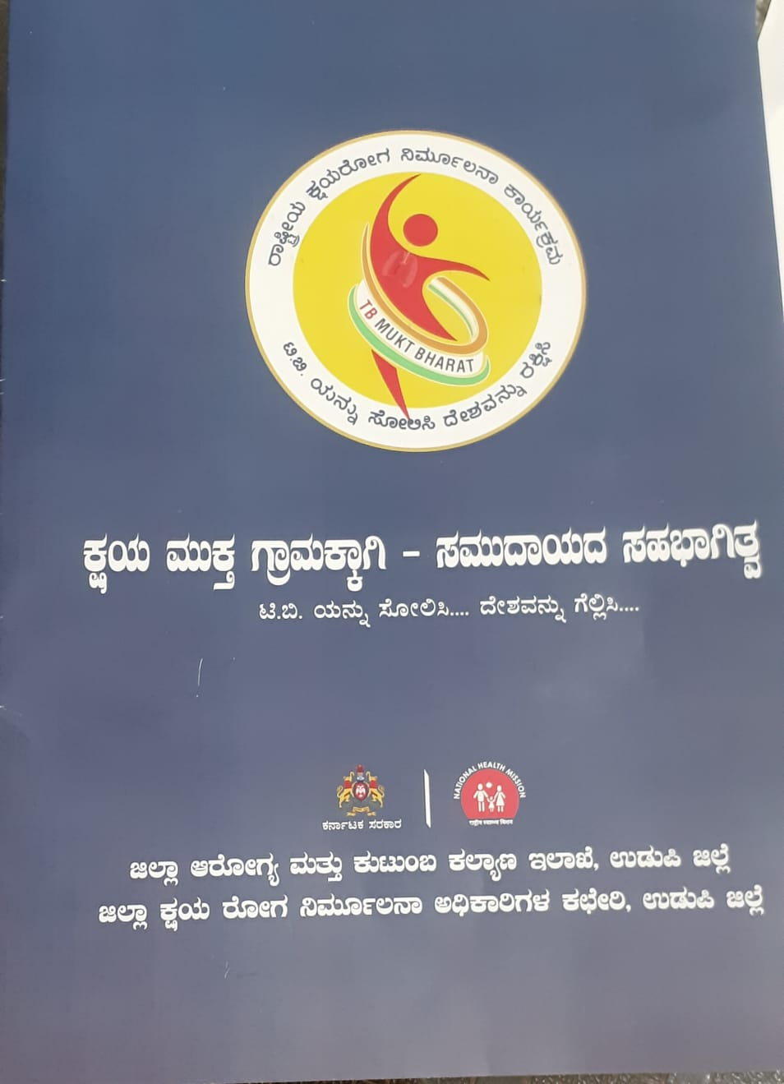
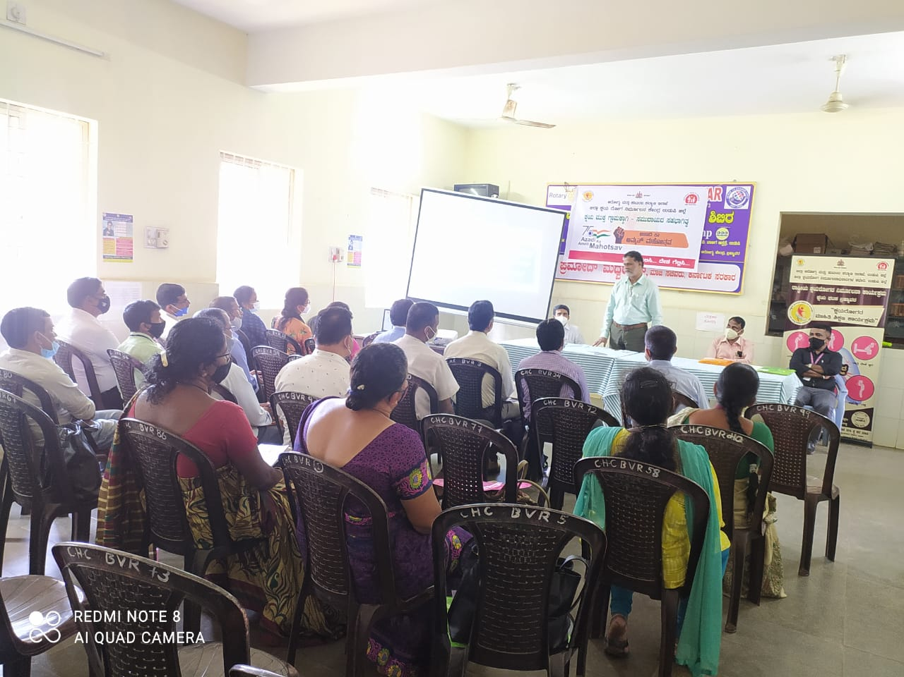

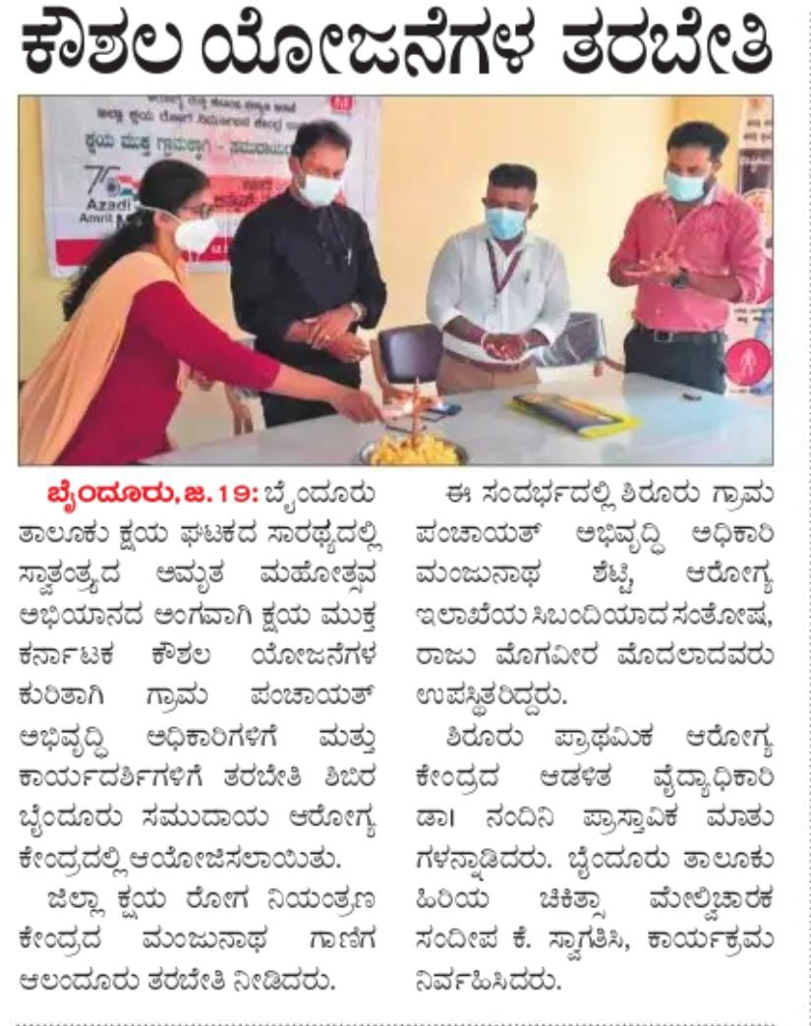
Capacity Building and Alignment
Capacity building : training module was developed in Kannada language, 16,782 grama-panchayat members were oriented and trained physically and virtually on TB activities
Alignment with existing Health Task force at the Panchayat level - 437 GPs have included senior treatment supervisors has members of Task force
Notes:
The training module contains information on the basics of TB, and step-by-step methods for planning Kshaya Mukta GP activities.
and also participatory sessions for perspective-building on inequities and health as holistic wellbeing, as well

Slide 9
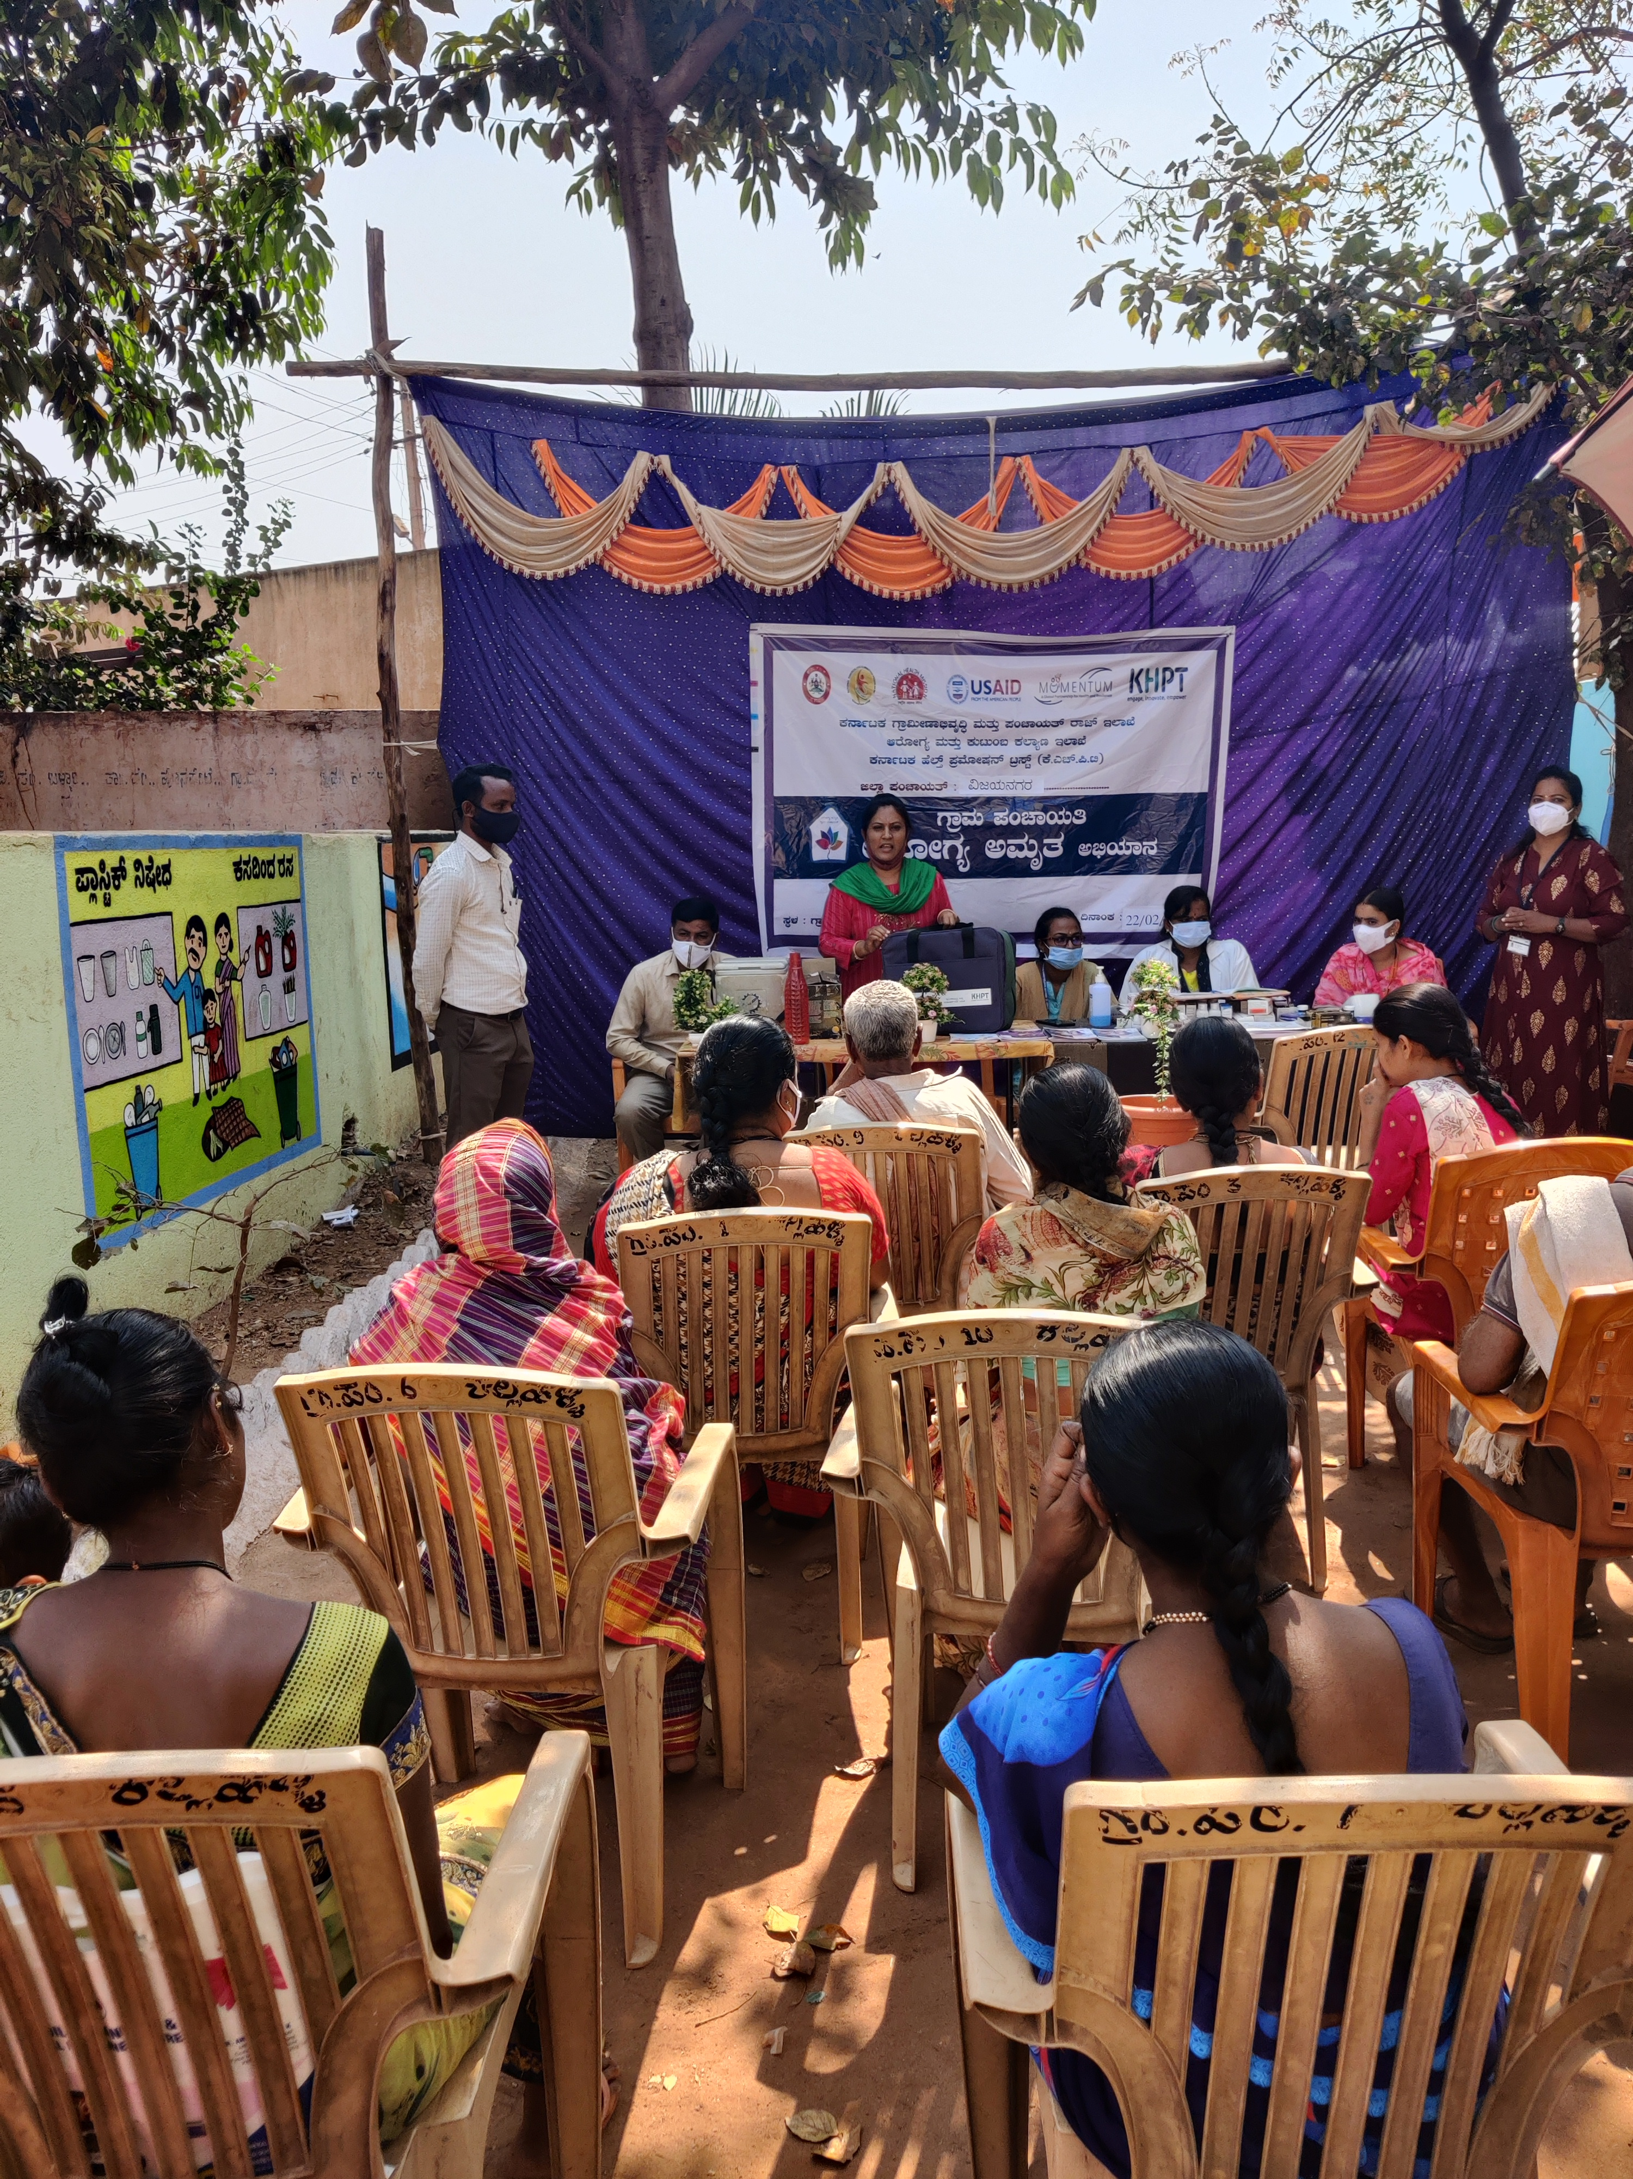
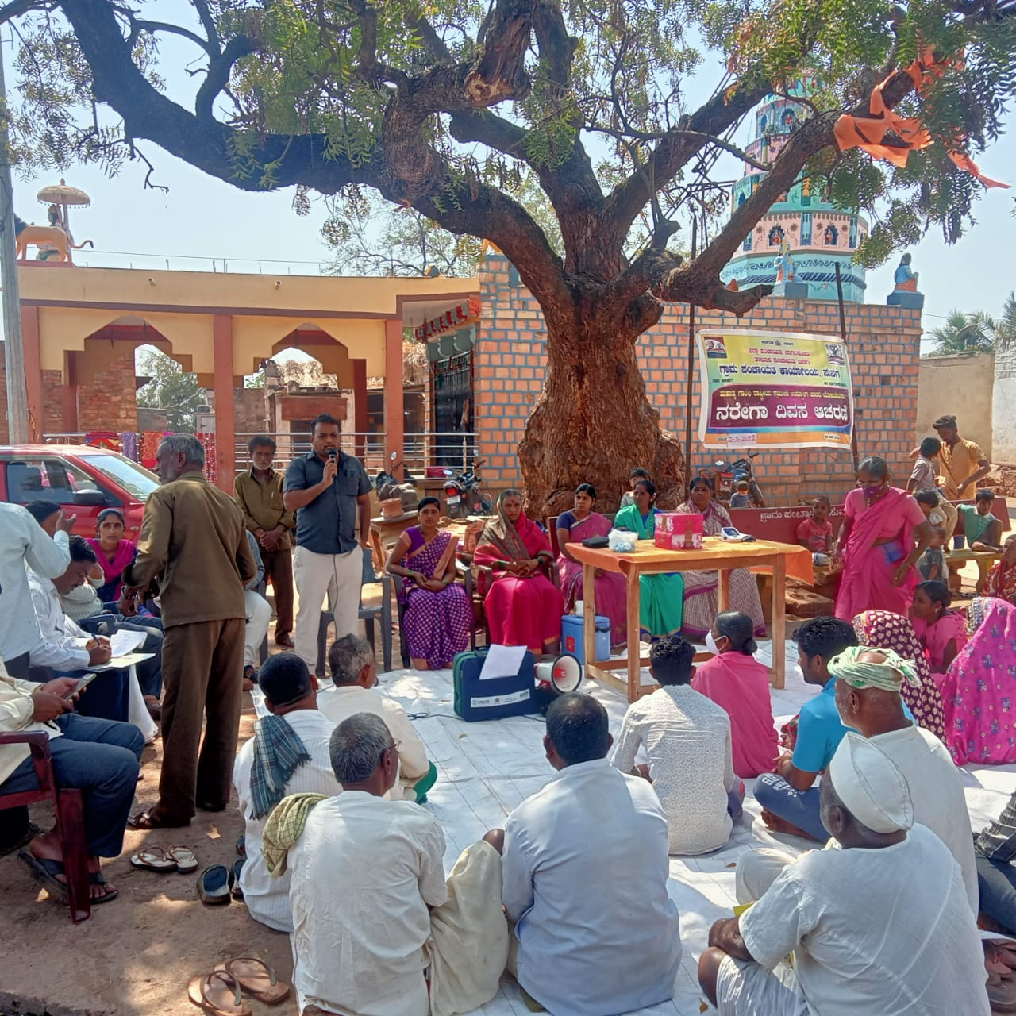
Graama Panchayath Arogya Amrutha Abhiyaana
A first-of-its-kind initiative in the country, to take health services to the doorstep of every poor household in rural Karnataka through the leadership of the elected representatives and local self governance bodies like the panchayat in partnership with KHPT.
Under GPAAA, 243 GPs selected for enhanced TB intervention and each GP has been recruited with one GP TB volunteer

Slide 10
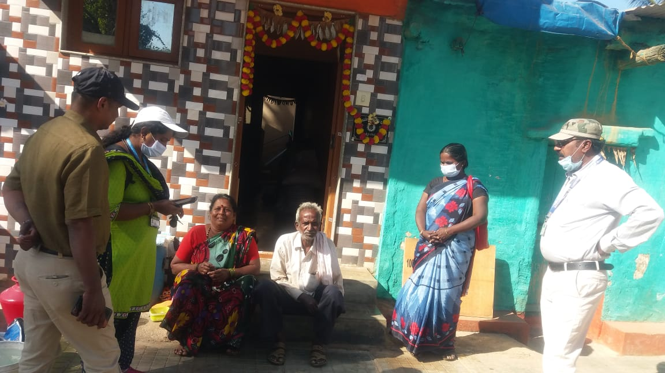
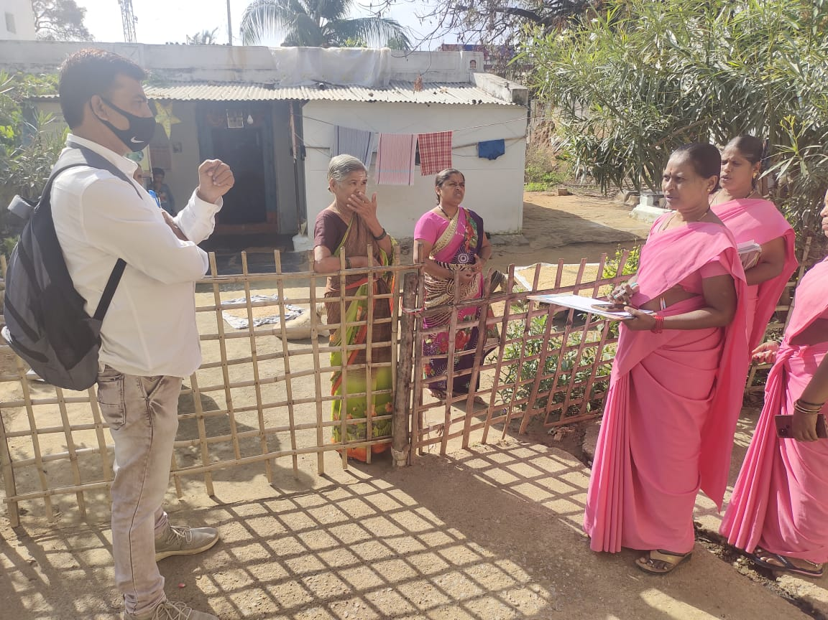
Kshaya Nivarana Andolana
Prevention of TB disease transmission through active case finding.Early TB case detection is a key to improved case notification, prevent TB infection, and further TB disease.
  1,64,246 individuals were verbally screened, 1,246(0.7%) presumptive TB patients were tested, and 47 TB patients were detected

Slide 11
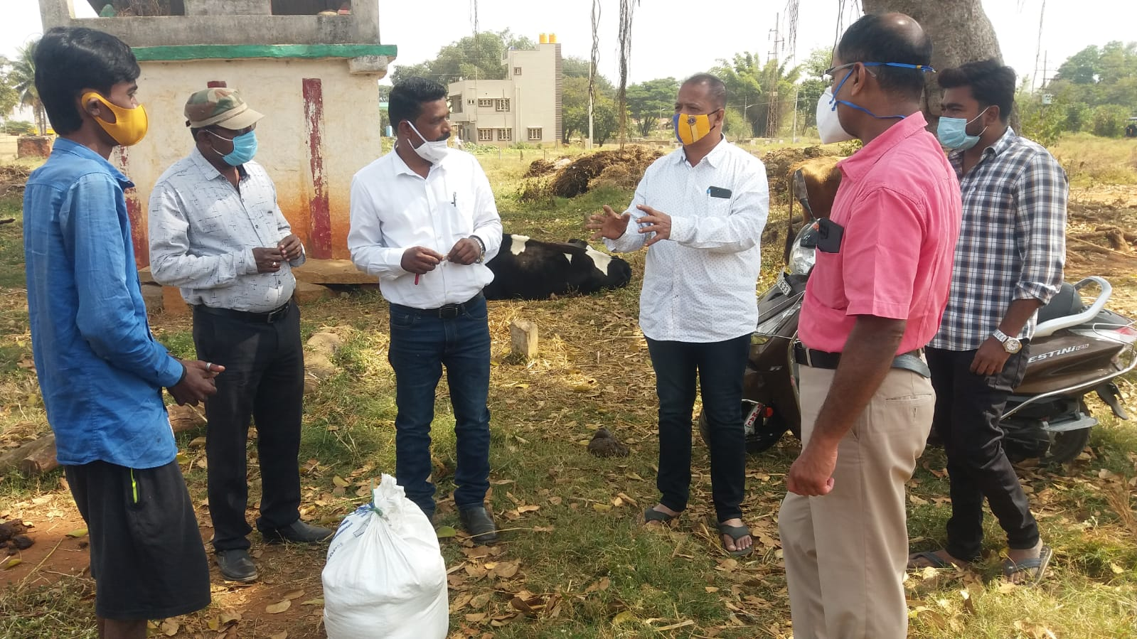
Kshaya Aasare
This initiative shall ensure access to information, free and quality services, and linkage to social welfare programs, empowering the patient for making decision to complete the treatment successfully.
  158 GPs have started the activity, 290 TB patients with undernutrition are being provided nutritional support
  Linkages with the employment, livelihood, and other schemes

Slide 12
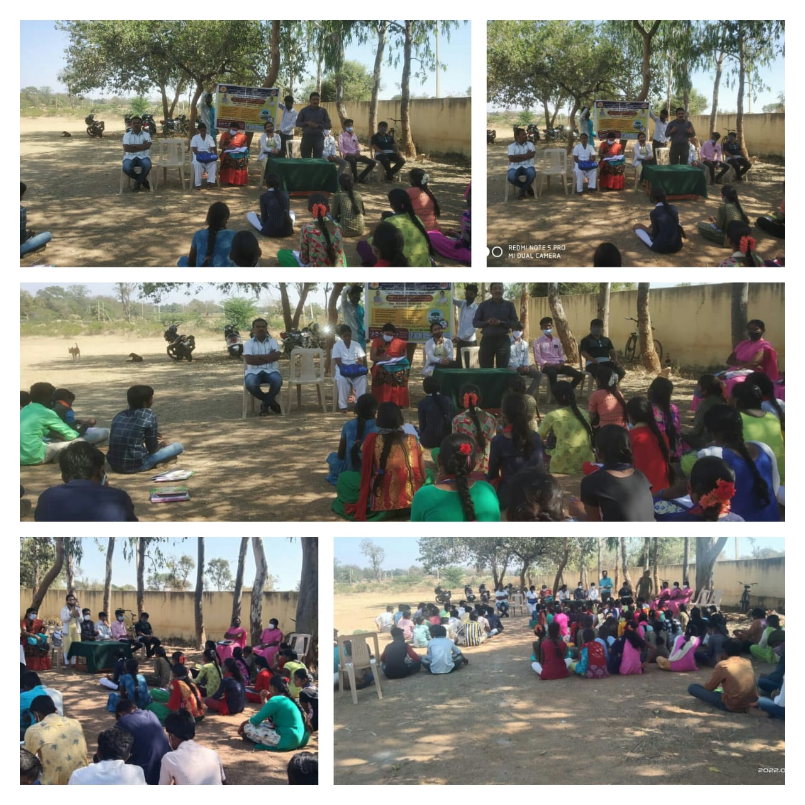
TB Sollisi GP Gellasi
Community engagement campaign are quite necessary for improving the access, awareness , demand generation for TB services and to reduce stigma associated with TB disease.
  363 GPs have started activity and held 557 IEC campaign sessions ( Street plays, essay & quiz competition, yakshagana, etc.) .

Slide 13
Road map
TB activity indicators in Gandhi Grama Puraskar assessment
Expansion of TB free activities in all Grama Panchayats
Mitigating the socio-economic vulnerabilities through linkages with social support schemes .
Preventing the stigma and discrimination
Ensuring the early diagnosis and compliance to the medications

Slide 14
Thank You

